Slide 1
Convolutional Neural Network (CNN)
Instructor: Dr. Yan Yan

Slide 2
Overview
Why CNN for Images
Some patterns are smaller than the whole image
The same patterns appear in different regions
Subsampling the pixels will not change the object
Convolutions Layers
Convolutions
Convolutions vs Fully Connected
Pooling Layers
Max Pooling
Average Pooling
What do CNN learn
Visualization
CNN applications
CNN for playing Go
CNN for speech and text analysis

Slide 3
Convolutional Neural Network
Instructor: Dr. Yan Yan

Slide 4
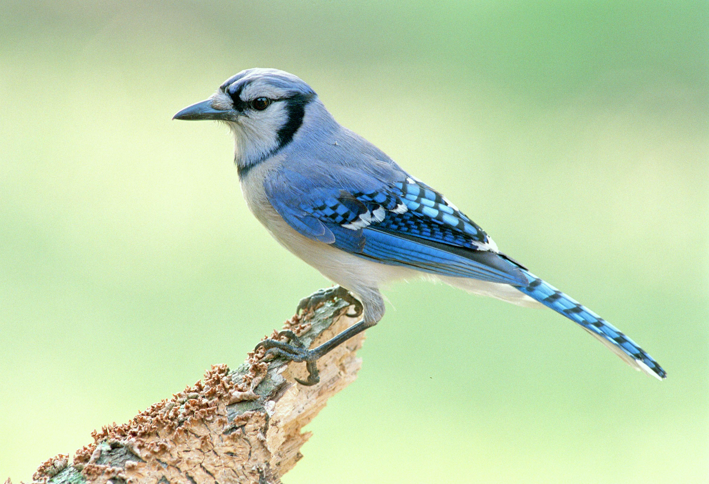
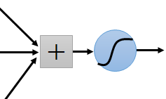

Why CNN for Image
Some patterns are much smaller than the whole image
A neuron does not have to see the whole image to discover the pattern
Connecting to small region with less parameters
“beak” detector

Slide 5
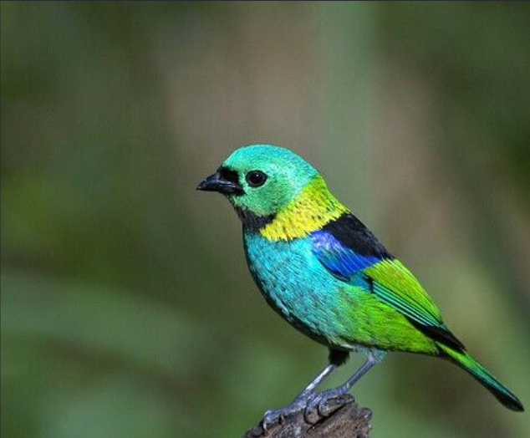
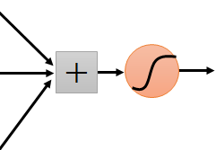
Why CNN for Image
The same patterns appear in different regions.
“upper-left beak” detector
Do almost the same thing
They can use the same set of parameters.
“middle beak” detector

Slide 6
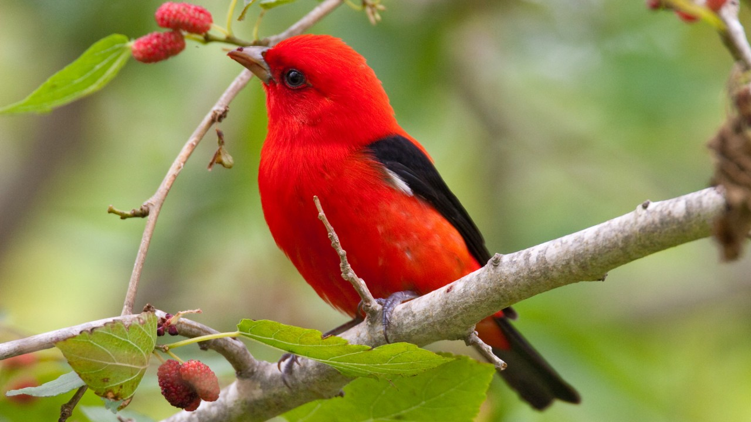
Why CNN for Image
Subsampling the pixels will not change the object
bird
bird
subsampling
We can subsample the pixels to make image smaller
Less parameters for the network to process the image

Slide 7
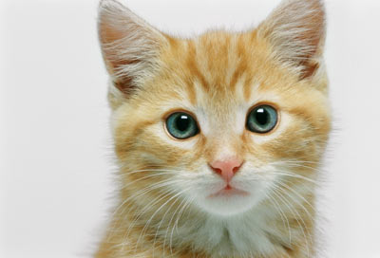
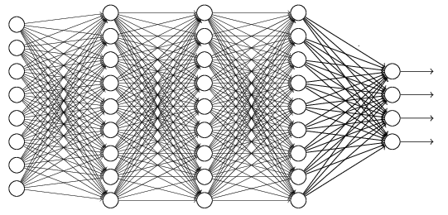
The whole CNN
cat dog ……
Convolution
Max Pooling
Can repeat many times
Fully Connected Feedforward network
Convolution
Max Pooling
Flatten

Slide 8
The whole CNN
第一个特性是 某些图案比整幅图像小得多。 第二个特性是 相同的图案出现在不同的区域， 这也是通过卷积层实现的。 第三个特性是像素下采样 不会改变对象本身， 这些特性是通过池化层实现的。 前两个特性是 卷积层实现的，第三个特性是最大池化层实现的。
Property 1
Some patterns are much smaller than the whole image
Convolution
Property 2
Max Pooling
The same patterns appear in different regions.
Can repeat many times
Property 3
Convolution
Subsampling the pixels will not change the object
Max Pooling
Flatten

Slide 9
CNN - Convolution
Instructor: Dr. Yan Yan

Slide 10
The whole CNN
cat dog ……
Convolution
Max Pooling
Can repeat many times
Fully Connected Feedforward network
Convolution
Max Pooling
Flatten

Slide 11
CNN – Convolution
Those are the network parameters to be learned.
1 | -1 | -1
-1 | 1 | -1
-1 | -1 | 1
1 | 0 | 0 | 0 | 0 | 1
0 | 1 | 0 | 0 | 1 | 0
0 | 0 | 1 | 1 | 0 | 0
1 | 0 | 0 | 0 | 1 | 0
0 | 1 | 0 | 0 | 1 | 0
0 | 0 | 1 | 0 | 1 | 0
Filter 1
Matrix
-1 | 1 | -1
-1 | 1 | -1
-1 | 1 | -1
Filter 2
Matrix
……
6 x 6 image
Each filter detects a small pattern (3 x 3).
Property 1

Slide 12
CNN – Convolution
1 | -1 | -1
-1 | 1 | -1
-1 | -1 | 1
Filter 1
stride=1
1 | 0 | 0 | 0 | 0 | 1
0 | 1 | 0 | 0 | 1 | 0
0 | 0 | 1 | 1 | 0 | 0
1 | 0 | 0 | 0 | 1 | 0
0 | 1 | 0 | 0 | 1 | 0
0 | 0 | 1 | 0 | 1 | 0
3
-1
6 x 6 image

Slide 13
CNN – Convolution
1 | -1 | -1
-1 | 1 | -1
-1 | -1 | 1
Filter 1
If stride=2
1 | 0 | 0 | 0 | 0 | 1
0 | 1 | 0 | 0 | 1 | 0
0 | 0 | 1 | 1 | 0 | 0
1 | 0 | 0 | 0 | 1 | 0
0 | 1 | 0 | 0 | 1 | 0
0 | 0 | 1 | 0 | 1 | 0
3
-3
We set stride=1 below
6 x 6 image

Slide 14
CNN – Convolution
1 | -1 | -1
-1 | 1 | -1
-1 | -1 | 1
Filter 1
stride=1
1 | 0 | 0 | 0 | 0 | 1
0 | 1 | 0 | 0 | 1 | 0
0 | 0 | 1 | 1 | 0 | 0
1 | 0 | 0 | 0 | 1 | 0
0 | 1 | 0 | 0 | 1 | 0
0 | 0 | 1 | 0 | 1 | 0
3
-1
-3
-1
-3
1
0
-3
-3
-3
0
1
3
-2
-2
-1
6 x 6 image
Property 2

Slide 15
CNN – Convolution
-1 | 1 | -1
-1 | 1 | -1
-1 | 1 | -1
Filter 2
stride=1
Do the same process for every filter
1 | 0 | 0 | 0 | 0 | 1
0 | 1 | 0 | 0 | 1 | 0
0 | 0 | 1 | 1 | 0 | 0
1 | 0 | 0 | 0 | 1 | 0
0 | 1 | 0 | 0 | 1 | 0
0 | 0 | 1 | 0 | 1 | 0
3
-1
-3
-1
-1
-1
-1
-1
-3
1
0
-3
-1
-1
-2
1
Feature
Map
-3
-3
0
1
-1
-1
-2
1
3
-2
-2
-1
6 x 6 image
-1
0
-4
3
4 x 4 image

Slide 16
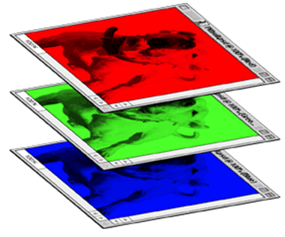
CNN – Colorful image
1 | -1 | -1
-1 | 1 | -1
-1 | -1 | 1
-1 | 1 | -1
-1 | 1 | -1
-1 | 1 | -1
1 | -1 | -1
-1 | 1 | -1
-1 | -1 | 1
-1 | 1 | -1
-1 | 1 | -1
-1 | 1 | -1
1 | -1 | -1
-1 | 1 | -1
-1 | -1 | 1
-1 | 1 | -1
-1 | 1 | -1
-1 | 1 | -1
Filter 1
Filter 2
Colorful image
1 | 0 | 0 | 0 | 0 | 1
0 | 1 | 0 | 0 | 1 | 0
0 | 0 | 1 | 1 | 0 | 0
1 | 0 | 0 | 0 | 1 | 0
0 | 1 | 0 | 0 | 1 | 0
0 | 0 | 1 | 0 | 1 | 0
1 | 0 | 0 | 0 | 0 | 1
0 | 1 | 0 | 0 | 1 | 0
0 | 0 | 1 | 1 | 0 | 0
1 | 0 | 0 | 0 | 1 | 0
0 | 1 | 0 | 0 | 1 | 0
0 | 0 | 1 | 0 | 1 | 0
1 | 0 | 0 | 0 | 0 | 1
0 | 1 | 0 | 0 | 1 | 0
0 | 0 | 1 | 1 | 0 | 0
1 | 0 | 0 | 0 | 1 | 0
0 | 1 | 0 | 0 | 1 | 0
0 | 0 | 1 | 0 | 1 | 0

Slide 17
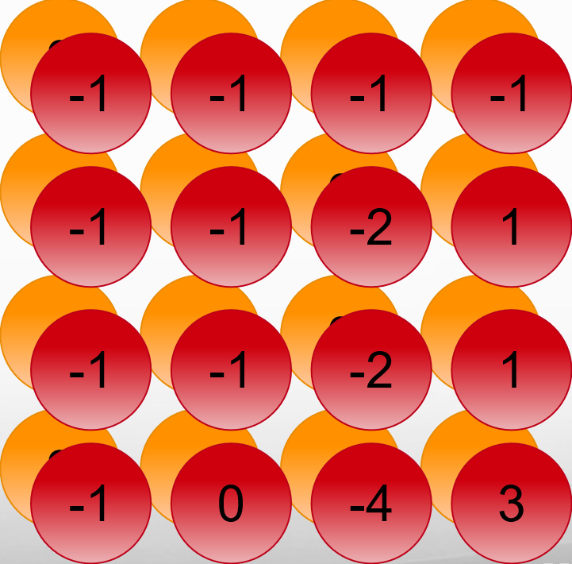
Convolution v.s. Fully Connected
1 | 0 | 0 | 0 | 0 | 1
0 | 1 | 0 | 0 | 1 | 0
0 | 0 | 1 | 1 | 0 | 0
1 | 0 | 0 | 0 | 1 | 0
0 | 1 | 0 | 0 | 1 | 0
0 | 0 | 1 | 0 | 1 | 0
1 | -1 | -1
-1 | 1 | -1
-1 | -1 | 1
-1 | 1 | -1
-1 | 1 | -1
-1 | 1 | -1
convolution
image
1 | 0 | 0 | 0 | 0 | 1
0 | 1 | 0 | 0 | 1 | 0
0 | 0 | 1 | 1 | 0 | 0
1 | 0 | 0 | 0 | 1 | 0
0 | 1 | 0 | 0 | 1 | 0
0 | 0 | 1 | 0 | 1 | 0
Fully-connected
……
……

Slide 18
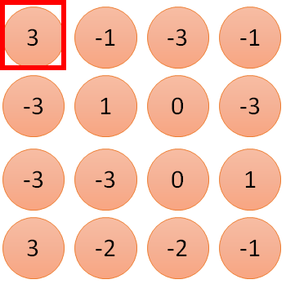
1 | -1 | -1
-1 | 1 | -1
-1 | -1 | 1
1:
1
Filter 1
2:
0
3:
0
3
4:
0
1 | 0 | 0 | 0 | 0 | 1
0 | 1 | 0 | 0 | 1 | 0
0 | 0 | 1 | 1 | 0 | 0
1 | 0 | 0 | 0 | 1 | 0
0 | 1 | 0 | 0 | 1 | 0
0 | 0 | 1 | 0 | 1 | 0
…
7:
0
8:
1
9:
0
10:
0
…
13:
0
6 x 6 image
14:
0
Less parameters!
15:
Only connect to 9 input, not fully connected
1
16:
1
…

Slide 19
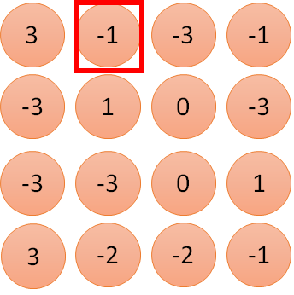
1 | -1 | -1
-1 | 1 | -1
-1 | -1 | 1
1:
1
Filter 1
2:
0
3:
0
3
4:
0
1 | 0 | 0 | 0 | 0 | 1
0 | 1 | 0 | 0 | 1 | 0
0 | 0 | 1 | 1 | 0 | 0
1 | 0 | 0 | 0 | 1 | 0
0 | 1 | 0 | 0 | 1 | 0
0 | 0 | 1 | 0 | 1 | 0
…
7:
0
8:
1
-1
9:
0
10:
0
…
13:
0
6 x 6 image
14:
0
Less parameters!
15:
1
Shared weights
16:
1
Even less parameters!
…

Slide 20
CNN – Max Pooling
Instructor: Dr. Yan Yan

Slide 21
The whole CNN
cat dog ……
Convolution
Max Pooling
Can repeat many times
Fully Connected Feedforward network
Convolution
Max Pooling
Flatten

Slide 22
CNN – Max Pooling
1 | -1 | -1
-1 | 1 | -1
-1 | -1 | 1
-1 | 1 | -1
-1 | 1 | -1
-1 | 1 | -1
Filter 1
Filter 2
3
-1
-3
-1
-1
-1
-1
-1
-3
1
0
-3
-1
-1
-2
1
-3
-3
0
1
-1
-1
-2
1
3
-2
-2
-1
-1
0
-4
3

Slide 23
CNN – Max Pooling
1 | 0 | 0 | 0 | 0 | 1
0 | 1 | 0 | 0 | 1 | 0
0 | 0 | 1 | 1 | 0 | 0
1 | 0 | 0 | 0 | 1 | 0
0 | 1 | 0 | 0 | 1 | 0
0 | 0 | 1 | 0 | 1 | 0
Conv
Max
Pooling
6 x 6 image
3
0
-1
1
New image
but smaller
Each filter
is a channel
3
1
0
3
2 x 2 image

Slide 24
The whole CNN
3
0
-1
1
Convolution
3
1
0
3
Max Pooling
Can repeat many times
A new image
Convolution
Smaller than the original image
The number of the channel is the number of filters
Max Pooling

Slide 25
The whole CNN
cat dog ……
Convolution
Max Pooling
A new image
Fully Connected Feedforward network
Convolution
Max Pooling
A new image
Flatten

Slide 26
Flatten
3
0
1
3
0
-1
1
3
3
1
0
3
-1
Flatten
1
Fully Connected Feedforward network
0
3

Slide 27


CNN in Keras
Only modified the network structure and input format (vector -> 3-D tensor)
input
Convolution
1 | -1 | -1
-1 | 1 | -1
-1 | -1 | 1
-1 | 1 | -1
-1 | 1 | -1
-1 | 1 | -1
There are 25 3x3 filters.
……
Max Pooling
Input_shape = ( 28 , 28 , 1)
28 x 28 pixels
1: black/white, 3: RGB
Convolution
3
-1
3
Max Pooling
-3
1

Slide 28
CNN in Keras
Only modified the network structure and input format (vector -> 3-D tensor)
input
1 x 28 x 28
Convolution
How many parameters for each filter?
9
25 x 26 x 26
Max Pooling
25 x 13 x 13
Convolution
How many parameters for each filter?
225
50 x 11 x 11
Max Pooling
50 x 5 x 5

Slide 29
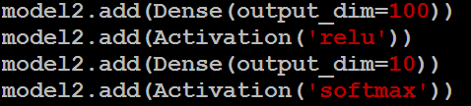
CNN in Keras
Only modified the network structure and input format (vector -> 3-D tensor)
input
1 x 28 x 28
output
Convolution
25 x 26 x 26
Fully Connected Feedforward network
Max Pooling
25 x 13 x 13
Convolution
50 x 11 x 11
Max Pooling
1250
50 x 5 x 5
Flatten

Slide 30
What does CNN learn?
Instructor: Dr. Yan Yan

Slide 31
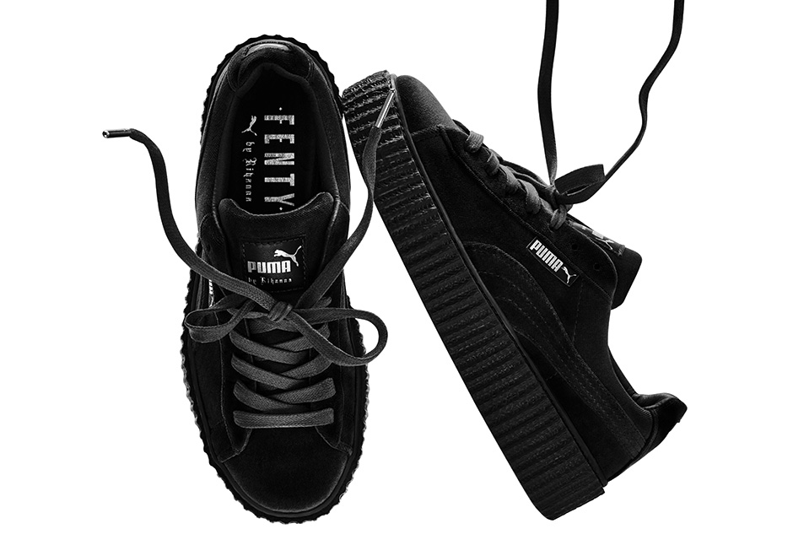

What does machine learn?
Shoes
Puma
http://newsneakernews.wpengine.netdna-cdn.com/wp-content/uploads/2016/11/rihanna-puma-creeper-velvet-release-date-02.jpg

Slide 32
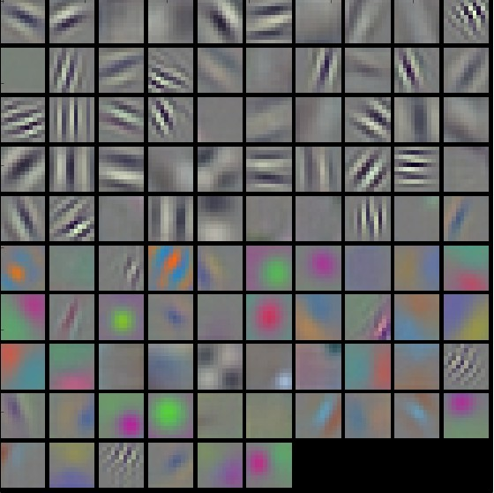
First Convolution Layer
Typical-looking filters on the trained first layer
11 x 11
(AlexNet)
http://cs231n.github.io/understanding-cnn/

Slide 33
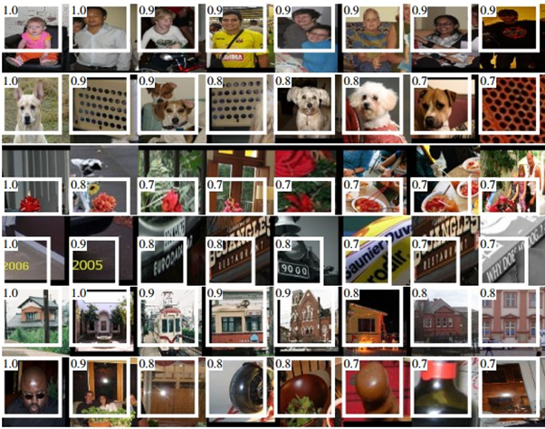
How about higher layers?
Which images make a specific neuron activate
Ross Girshick, Jeff Donahue, Trevor Darrell, Jitendra Malik, “Rich feature hierarchies for accurate object detection and semantic segmentation”, CVPR, 2014

Slide 34

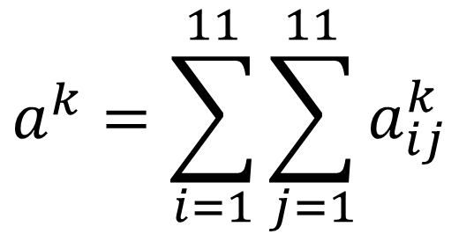
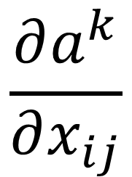
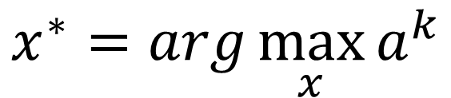
What does CNN learn?
$$\frac{∂a^{k}}{∂x_{ij}}$$
The output of the k-th filter is a 11 x 11 matrix.
x
input
Degree of the activation of the k-th filter:
$$a^{k}=\sum_{i=1}^{11}{\sum_{j=1}^{11}{a_{ij}^{k}}}$$
25 3x3 filters
Convolution
$$x^{∗}=arg\max_{x}{a^{k}}$$
(gradient ascent)
11
Max Pooling
3
-1
…
-1
50 3x3 filters
$$a_{ij}^{k}$$
Convolution
-3
1
…
-3
11
50 x 11 x 11
…
…
…
Max Pooling
3
-2
…
-1

Slide 35

What does CNN learn?
$$\frac{∂a^{k}}{∂x_{ij}}$$
The output of the k-th filter is a 11 x 11 matrix.
input
Degree of the activation of the k-th filter:
$$a^{k}=\sum_{i=1}^{11}{\sum_{j=1}^{11}{a_{ij}^{k}}}$$
25 3x3 filters
Convolution
$$x^{∗}=arg\max_{x}{a^{k}}$$
(gradient ascent)
Max Pooling
50 3x3 filters
Convolution
50 x 11 x 11
Max Pooling

Slide 36

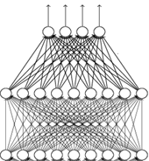
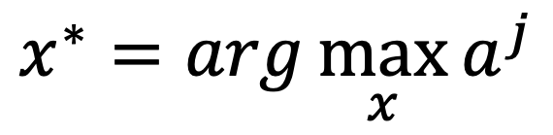
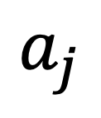
What does CNN learn?
input
Find an image maximizing the output of neuron:
Convolution
$$x^{∗}=arg\max_{x}{a^{j}}$$
Max Pooling
Convolution
Max Pooling
Flatten
$$a_{j}$$
Each figure corresponds to a neuron

Slide 37

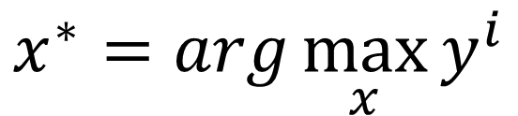
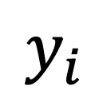
What does CNN learn?
input
$$x^{∗}=arg\max_{x}{y^{i}}$$
Can we see digits?
Convolution
Max Pooling
0
1
2
Convolution
Max Pooling
3
4
5
Flatten
6
7
8
Deep Neural Networks are Easily Fooled
https://www.youtube.com/watch?v=M2IebCN9Ht4
$$y_{i}$$

Slide 38

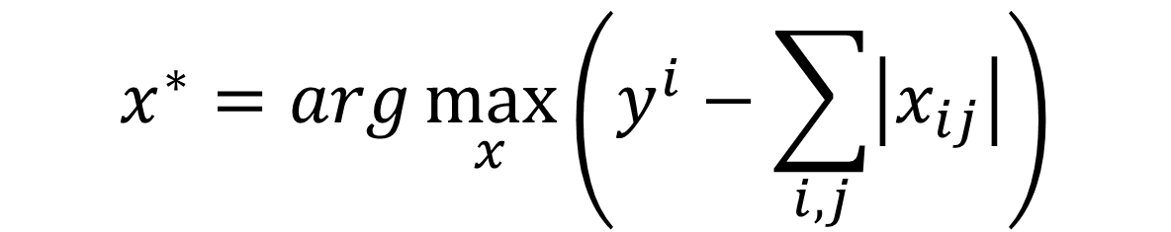
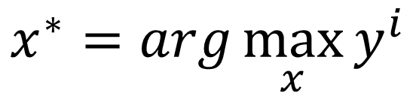
What does CNN learn?
Over all pixel values
$$x^{∗}=arg\max_{x}\left(y^{i}−\sum_{i,j}{\left|x_{ij}\right|}\right)$$
$$x^{∗}=arg\max_{x}{y^{i}}$$
0
1
2
0
1
2
3
4
5
3
4
5
6
7
8
6
7
8

Slide 39
Applications of CNN
Instructor: Dr. Yan Yan

Slide 40
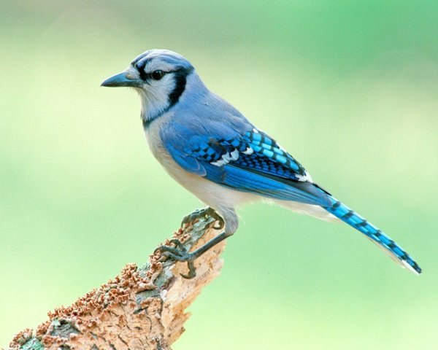
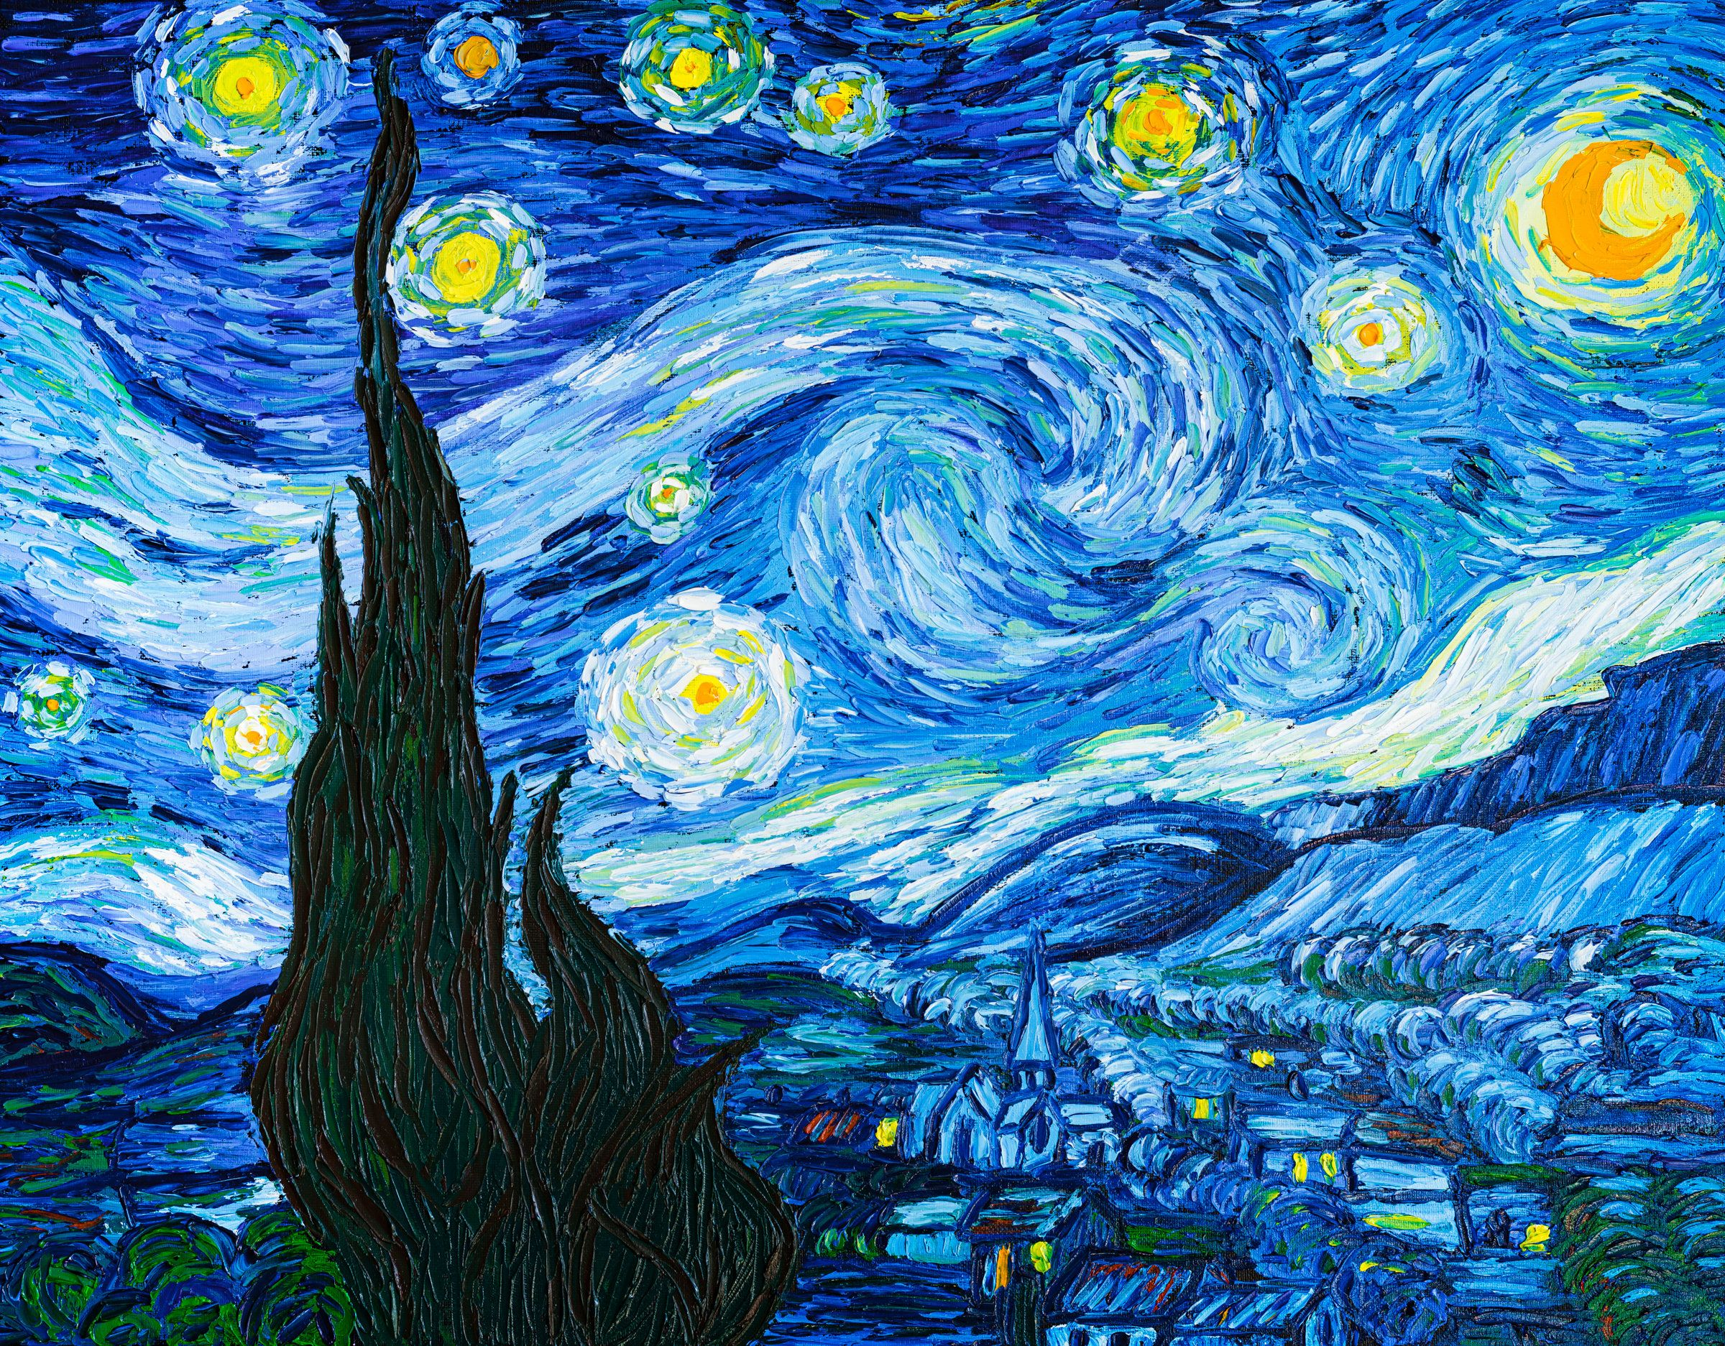
Deep Style
Given a photo, make its style like famous paintings
https://goart.fotor.com/

Slide 41
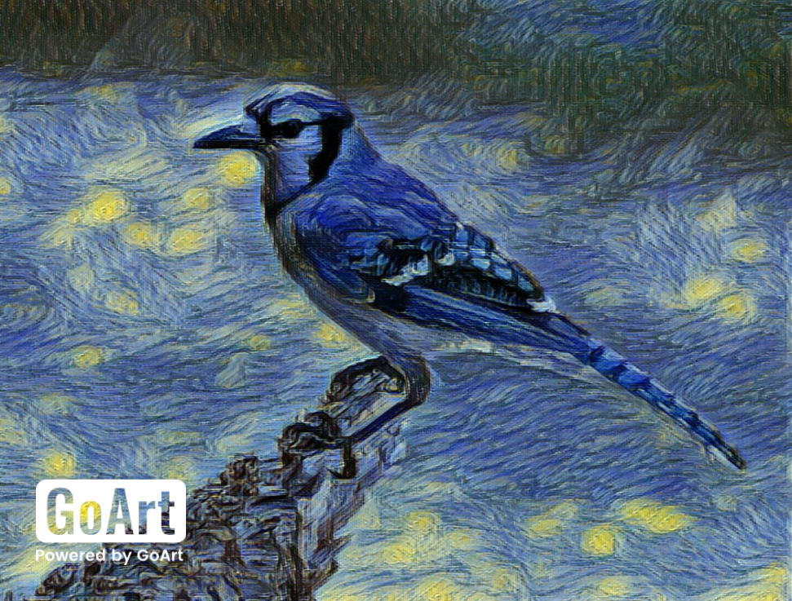
Deep Style
Given a photo, make its style like famous paintings
https://goart.fotor.com/

Slide 42
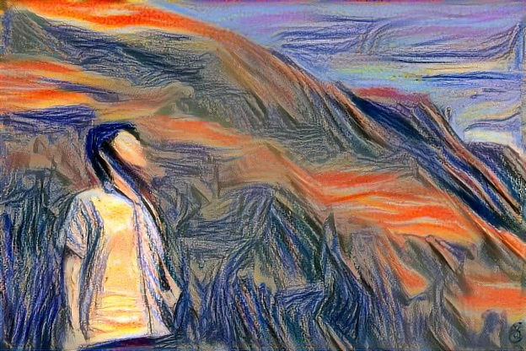
Deep Style
CNN
CNN
A Neural Algorithm of Artistic Style
https://arxiv.org/abs/1508.06576
content
style
CNN
?
Notes:
Find a image to max both content and style

Slide 43
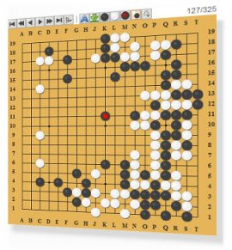
More Application: Playing Go
Network
Next move
(19 x 19 positions)
19 x 19 matrix (image)
19 x 19 vector
19 x 19 vector
Fully-connected feedforward network can be used
Black: 1
white: -1
none: 0
But CNN performs much better.

Slide 44
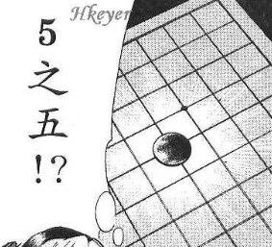


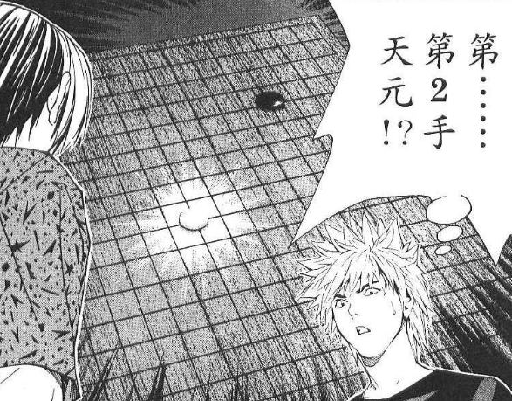
More Application: Playing Go
record of previous plays
Training:
Black: 5 5
White: Tengen
Black: 5 5 …
Target:
“Tengen” = 1
else = 0
CNN
Target:
“5 5” = 1
else = 0
CNN

Slide 45
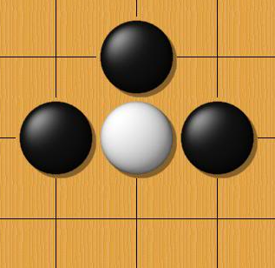
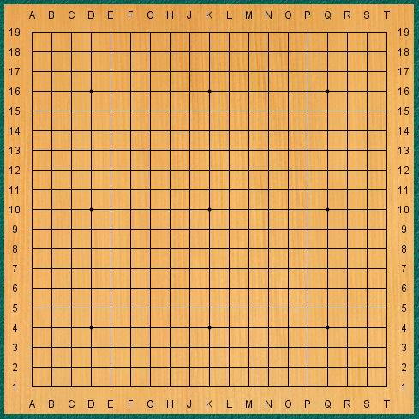
Why CNN for playing Go?
Some patterns are much smaller than the whole image
The same patterns appear in different regions.
Alpha Go uses 5 x 5 for first layer

Slide 46
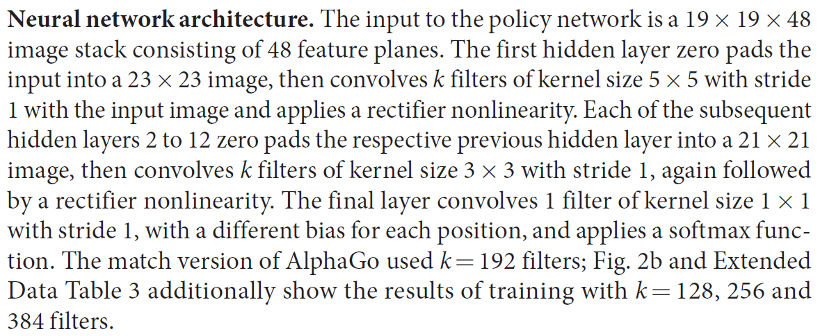
Why CNN for playing Go?
Subsampling the pixels will not change the object
Max Pooling
How to explain this???
Alpha Go does not use Max Pooling ……
Notes:
Very good example for desing your network

Slide 47
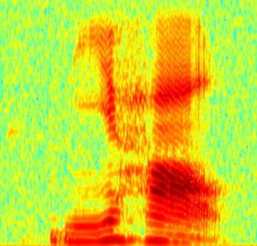
More Application: Speech
The filters move in the frequency direction.
CNN
Frequency
Image
Time
Spectrogram

Slide 48
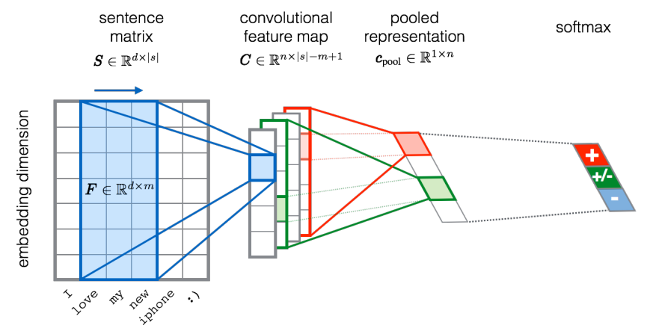
More Application: Text
?
Source of image: http://citeseerx.ist.psu.edu/viewdoc/download?doi=10.1.1.703.6858&rep=rep1&type=pdf

